Slide 1
Mechanism Design
John P Dickerson & Marina Knittel
Lecture #1 – 01/24/2022
CMSC498T
Mondays & Wednesdays
2:00pm – 3:15pm

Slide 2
Markets come in many forms …
… some of which don’t conform to conventional notions of markets …
… and some in which money may play little or no role.
– excerpt from Who Gets What – and Why
Notes:
Markets and marketplaces come in many forms …
… some of which don’t conform to conventional notions of markets …
… and some in which money may play little or no role.

Slide 3
Aesthetically-displeasing One-Slide Course Summary
Mechanism design is a field in economics and game theory that takes an engineering approach to designing economic mechanisms or incentives, toward desired objectives, in strategic settings, where players act rationally.
AKA “reverse game theory” – we’re designing the rules of the game, not figuring out how to play it.
This course: can we design mechanisms for societal problems that perform well in practice, are computationally tractable, and whose workings and results are understandable by humans?
More info: https://mech-design.github.io/

Slide 4
Prerequisite Knowledge
Aimed at strong, senior CS undergraduates – but likely, with substantial effort, accessible to others with mathematical maturity and interest.
Assuming:
Basic CS undergrad knowledge of theory (correctness proofs, NP-hardness, impossibility results)
Basic CS/Math undergrad knowledge of optimization
Convex optimization, LPs, IPs – one lecture of primer, too
Basic CS/Math undergrad knowledge of statistics and probability
Ability to consume scientific papers (CS, Econ, OR)
All of this can be learned on the fly! Recommended books …

Slide 5
Book #1: “The AGT BOOK”
It’s free online! Check the course webpage.

Slide 6
Book #2: “CSC Handbook”
It’s free online! Check the course webpage.

Slide 7
Book #3: “Matching Market Design”
It’s not free online! UMD has one copy. We can find alternatives.

Slide 8
Book #4: “Combinatorial Auctions”
It’s free online! Check the course webpage.

Slide 9
Book #5: “The Ethical Algorithm”
It’s not free online! UMD might have a copy? We can find alternatives

Slide 10






Single-slide version of John
2004 – 2008
2010 – 2016
2016 – ∞
2018 – 2020
{ Advisory roles in UMD alumni’s startups }
2017 – now
{ Advisory role to a US regulatory agency }
Late 2019 +

Slide 11

Single (Live!) Slide version of Marina …

Slide 12
Who are you?
PhD/MSc/BSc?
Area?
Background in: CS, game theory, mechanism design, HCI?
Interest in this course?
Goals in life? And goals for this course?
Advisor?
Let’s meet each other on Slack: https://piazza.com/umd/spring2022/cmsc498t/home

Slide 13
Course structure
First 5-6 lectures: primers in GT/MD and optimization
Next 23 lectures: theory + application areas
Security games
Deep learning for mechanism design
Healthcare markets (organ allocation, financing R&D)
Food allocation
Learning for mechanism design
Fair clustering
Combinatorial assignment (bidding on courses)
Incentive auctions (FCC spectrum allocation)
Fair Division (allocating rooms to schools)
Voting
School choice (assigning kids to schools)
Prediction markets
Ambitious …

Slide 14
Grade #1: Project
Students will complete a semester-long course project on something related to market and mechanism design.
Individual or small group
100% theory, 100% applied, or convex combination
Goal: create something publishable!
Important dates:
Project proposals will be due in early March
Project presentations will be during the last two lectures
Project writeups—formatted as, say, a NeurIPS conference paper or similar—will be due by the exam date for this course (Monday, May 26 at 1:30pm).

Slide 15
Grade #2: Present a paper (on Zoom/YouTube/etc), or Write up a blog Post summary
Attendees will pick two papers (or papers, or chapter, or topic, or …) to present, and will create a small video recording (let’s say 15 minutes, but this is flexible – if you have an accessibility concern, please let me know) that we can post online! (Also fine to do a blog post if you’d prefer not to do a video.)
Good for you!
Good for your fellow classmates!
Good for the public!
Check out the course webpage for topics
Also: feel free to suggest a topic you like!
Logistics:
We’ll figure this out in second week

Slide 16
Class Participation
Please please please please please read the paper(s) before coming to class!
I want to speak with you, not at you …
Also, looking forward to your video presentations!
Participate on Piazza, help brainstorm project ideas, ask questions in class, answer questions in class, etc.

Slide 17
Grade Breakdown | Qualifier Approval
60% course project:
5% project proposal (mid March)
5% project checkup (April)
15% presentation (early May)
35% writeup (exam period)
30% Examinations:
15% presenting/summarizing a paper/idea #1
15% presenting/summarizing a paper/idea #2
10% Pass/Fail Quizzes

Slide 18
Important Walls of Text

Slide 19
Anti-Harassment
(Adapted from ACM SIGCOMM’s policies)
The open exchange of ideas and the freedom of thought and expression are central to our aims and goals. These require an environment that recognizes the inherent worth of every person and group, that fosters dignity, understanding, and mutual respect, and that embraces diversity. For these reasons, we are dedicated to providing a harassment-free experience for participants in (and out) of this class.
Harassment is unwelcome or hostile behavior, including speech that intimidates, creates discomfort, or interferes with a person's participation or opportunity for participation, in a conference, event or program.
Common Sense!

Slide 20
Academic Integrity
Common Sense!
(Text unironically stolen from Hal Daumé III)
Any assignment or exam that is handed in must be your own work (unless otherwise stated). However, talking with one another to understand the material better is strongly encouraged. Recognizing the distinction between cheating and cooperation is very important. If you copy someone else's solution, you are cheating. If you let someone else copy your solution, you are cheating (this includes posting solutions online in a public place). If someone dictates a solution to you, you are cheating.
Everything you hand in must be in your own words, and based on your own understanding of the solution. If someone helps you understand the problem during a high-level discussion, you are not cheating. We strongly encourage students to help one another understand the material presented in class, in the book, and general issues relevant to the assignments. When taking an exam, you must work independently. Any collaboration during an exam will be considered cheating. Any student who is caught cheating will be given an F in the course and referred to the University Office of Student Conduct. Please don't take that chance – if you're having trouble understanding the material, please let me know and I will be more than happy to help.

Slide 21
Example Application Areas Many of which we’ll cover in future classes

Slide 22












Example: Matching markets
In matching problems, prices do not do all – or any – of the work
Agents are paired with other (groups of) agents, transactions, or contracts
Workers to firms
Children to schools
Residents to hospitals
Patients to deceased donors
Advertisements to viewers
Riders to rideshare drivers

Slide 23





Uncertainty in Matching Markets
Does a matched edge truly exist?
How valuable is a match?
Will a better match arrive in the future?
F
?
W

Slide 24


Competition in Matching Markets
Rival matching markets compete over the same agents
How does this affect global social welfare?
How to differentiate?

Slide 25



Cadence of Matching Markets
FREQUENCY
How quickly do new edges form?
How frequently does a market clear?
Is clearing centralized or decentralized?
Can agents reenter the market?

Slide 26

Example: Resident-Hospital Assignment
1940s: decentralized resident-hospital matching
Market “unraveled”, offers came earlier and earlier, quality of matches decreased
1950s: NRMP introduces hospital-proposing deferred acceptance algorithm
1970s: couples increasingly don’t use NRMP
1998: matching with couple constraints
(Stable matching may not exist anymore …)
Take-home message Looks like: M.D.s aren’t the only type of doctor who help people!

Slide 27
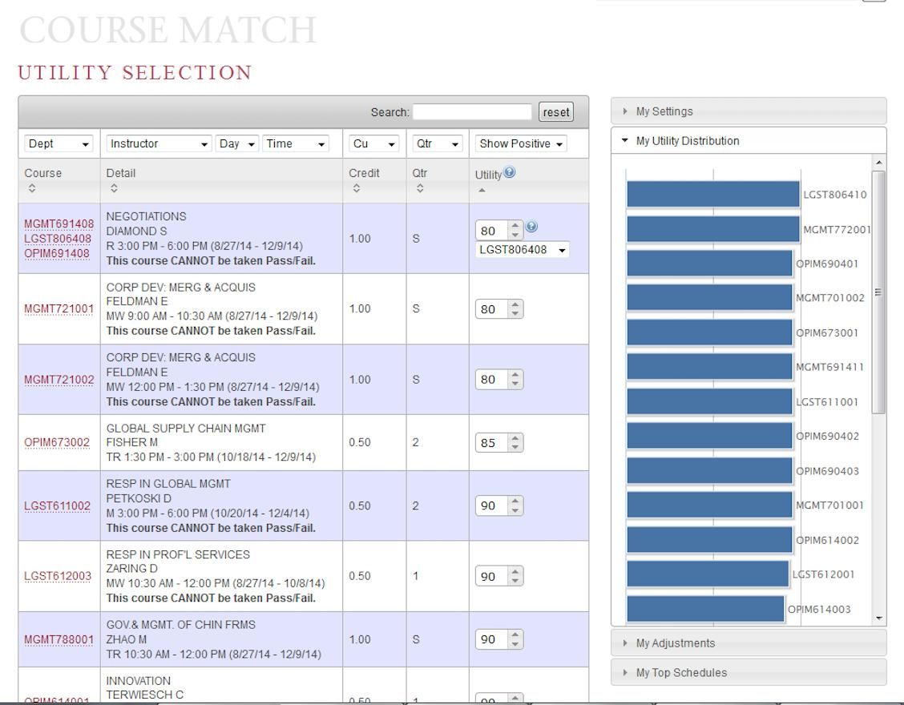
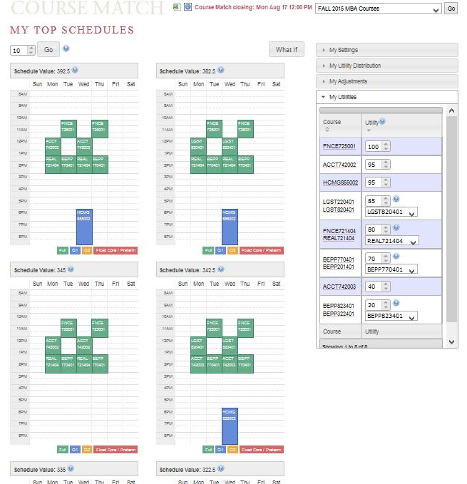
Example: Combinatorial course allocation [Images from Budish et al. working paper 2016]
Dynamic exclusions
Bidding
“Funny money” used for bidding

Slide 28
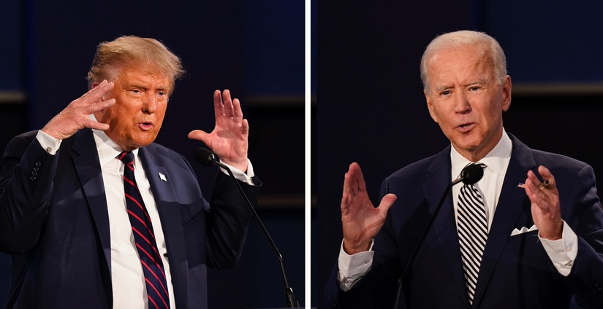
Example: Voting
Set of voters N and a set of alternatives: {Joe Biden, Bernie Sanders, Donald Trump}
Each voter ranks the candidates:
v₁: Donald Trump > Bernie > Joe Biden
v₂: Joe Biden > Bernie > Donald Trump
… A preference profile is the set of all voters’ rankings
Can we choose a voting rule – that is, a function that takes preference profiles and returns a winning alternative – that:
“Behaves well”
Isn’t manipulable by strategic agents

Slide 29

Example: fair allocation
http://spliddit.org
Divisible goods:
Splitting land, cutting cake
Indivisible goods:
Splitting up assets after divorce (house, cars, pets)
A chief concern: defining and guaranteeing the fairness of the final allocation
An allocation is envy free if each player values her own allocated set of goods at least as highly as any other player’s allocated set
When do envy-free allocations exist? How can we compute them? What can we do when they don’t exist?

Slide 30
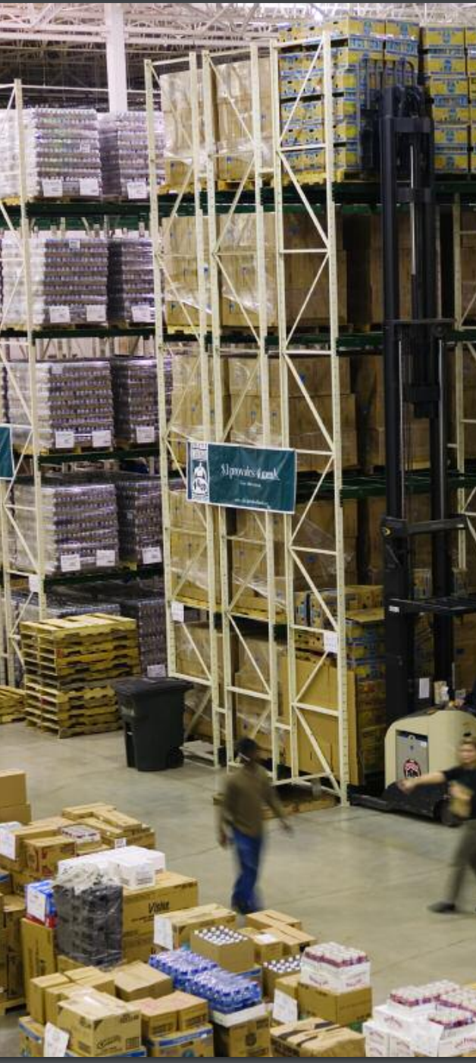
Example: Food Bank Allocation
Food banks supply nutrition to the needy for free or at a reduced cost
Much of that food comes from donors (e.g. supermarkets, manufacturers)
Distribution is overseen by a large non-profit organization, Feeding America
Previously: centralized allocation based on perceived need of food banks
Currently: food banks bid in an online auction using a fake currency for loads of donated food.

Slide 31
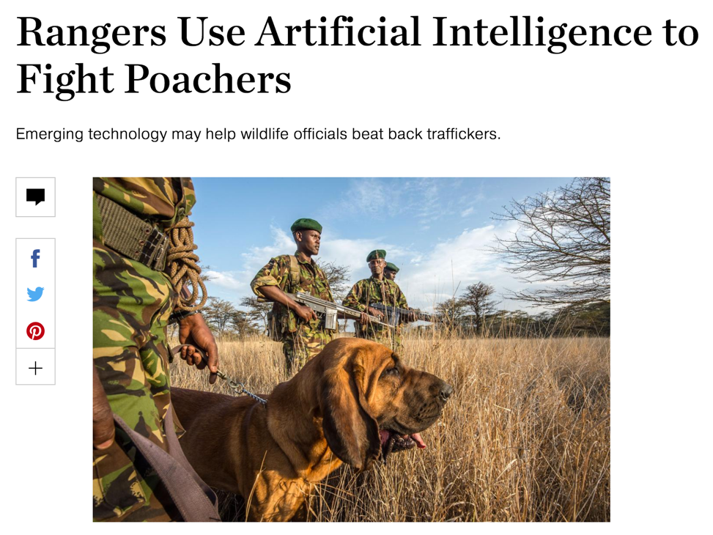
Example: Security GAmes
Where should we deploy security forces (checkpoints, cop cars, dogs, troops), assuming a rational adversary who can observe our deployment strategy?
Checkpoints at airports
Patrol routes on the water on the borders
Anti-poacher teams near big game
How do we compute these strategies?
What if the adversary isn’t rational?

Slide 32
Example: Kidney Transplantation
Demand
US waitlist: over 100,000
36,157 added in 2014
4,537 people died while waiting
11,559 people received a kidney from the deceased donor waitlist
5,283 people received a kidney from a living donor
Some through kidney exchanges
(We work extensively with the UNOS exchange.)
Supply
[Roth et al. 2004]

Slide 33
Example: Deceased-Donor Allocation
Online bipartite matching problem:
Set of patients is known (roughly) in advance
Organs arrive and must be dispatched quickly
Constraints:
Locality: organs only stay good for 24 hours
Blood type, tissue type, etc.
Who gets the organ? Prioritization based on:
Age?
QALY maximization?
Quality of match?
Time on the waiting list?

Slide 34
Kidney transplantation
US waitlist: a bit under 100,000
35,000 – 40,000 added per year
~4,000 people died while waiting
~15,000 people received a kidney from the deceased donor waitlist
6,500+ people received a kidney from a living donor
Some through kidney exchanges!
This talk: experience with UNOS national kidney exchange
Demand
Supply
[Roth et al. 2004]
Notes:
United Kingdom National Health Service National Living Donor Kidney Sharing Schemes

Slide 35




Example: Kidney exchange
Wife
Husband
D₁ P₁
D₃ P₃
Donors
Patients
D₅ P₅
D₂ P₂
D₄ P₄
Brother
Brother
(2- and 3-cycles, all surgeries performed simultaneously)

Slide 36
Non-directed donors & chains
[Rees et al. 2009]
NDD
D1
D2
D3
…
Pay it forward
P1
P2
P3
Not executed simultaneously, so no length cap based on logistic concerns …
… but in practice edges fail & chains execute over many years, so some finite cap is used while planning a single match run.
Notes:
NYTimes – 2012
University of Alabama at Birmingham -- 2018

Slide 37
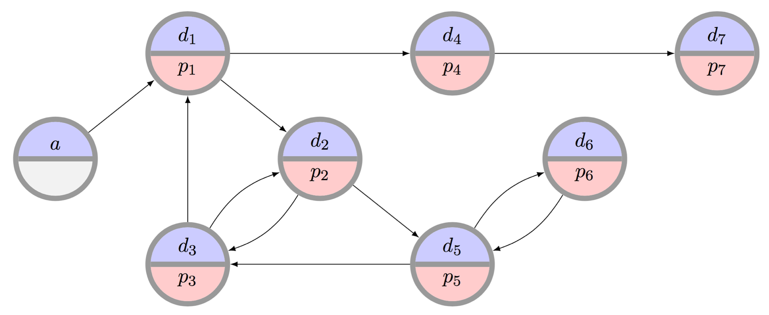
The clearing problem
The standard clearing problem is to find the “best” disjoint set of cycles of length at most L, and chains
Typically, 2 ≤ L ≤ 5 for kidneys (e.g., L=3 at UNOS)
NP-hard (for L>2) in theory, really hard in practice
[Abraham et al. 07, Constantino et al. 13, Glorie et al. 14, Klimentova et al. 14, Anderson et al. 15, Manlove & O’Malley 15, Plaut et al. 16, Dickerson et al. 16, Mak-Hau 17, McElfresh et al. 19, ...]
[Abraham et al. 07, Biro et al. 09]

Slide 38

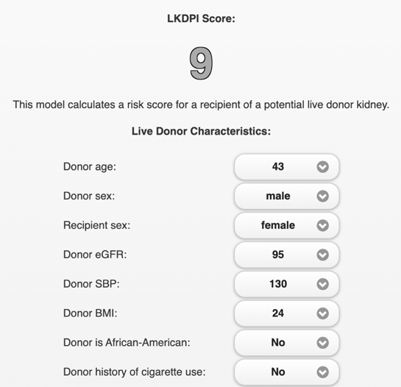
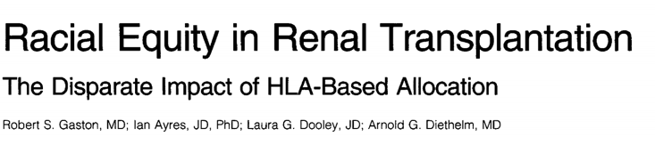
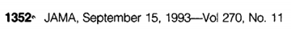
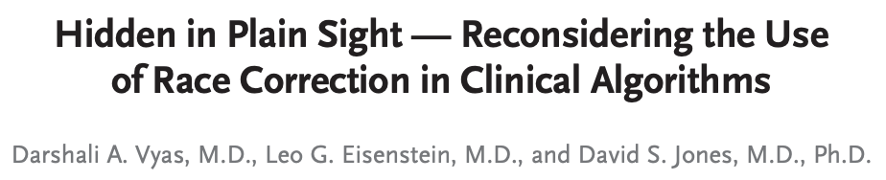
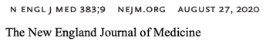
Lots of moving parts & competing wants
Distribution drift:
Supply & demand shifts:
Demographic (aging population, racial shift)
Obesity, alcohol, …
Shocks to the system:
30% living donation drop
21% deceased donation drop – COVID
Concerns of fairness:
Race
Socio-economic status
Age
Geographic location
Access to information
Health characteristics (e.g., blood type, HLA)
Having had children
…
[ChronicleHerald, 2021]
Legal landscape, social norms, international exchange, money, insurance, NP-hardness, noisy data, incentive problems, dynamics, competition, …

Slide 39
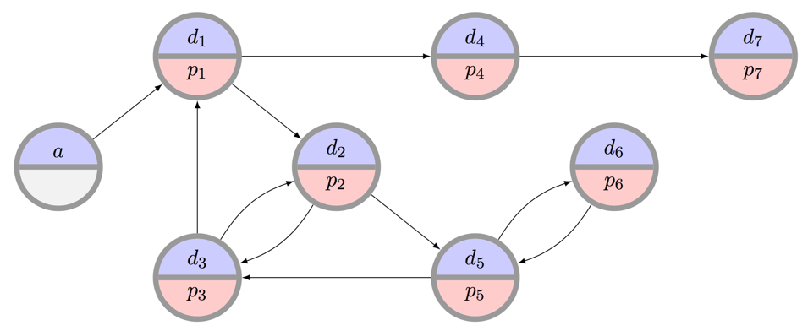

Example: Kidney Exchange
What is the “best” matching objective?
Maximize matches right now or over time?
Maximize transplants or matches?
Prioritization schemes (i.e. fairness)?
Modeling choices?
Incentives? Ethics? Legality?
Can we design a mechanism that performs well in practice, is computationally tractable, and is understandable by humans?

Slide 40
Techniques we’ll use (Next three lectures will cover these, In the context of Mechanism Design)

Slide 41
Combinatorial Optimization
Combinatorial optimization lets us select the “best element” from a set of elements.
Some PTIME problems:
Some forms of matching
2-player zero-sum Nash
Compact LPs
Some PPAD- or NP-hard problems:
More complex forms of matching
Many equilibrium computations
Some > NP-hard problems:
Randomizing over a set of all feasible X, where all feasible X must be enumerated (#P-complete)

Slide 42
C.O. for Kidney Exchange: The Edge formulation
[Abraham et al. 2007]
Binary variable x_{ij} for each edge from i to j
Maximize
u(M) = Σ w_{ij} x_{ij}
Subject to
Σ_{j} x_{ij} = Σ_{j} x_{ji} for each vertex i
Σ_{j} x_{ij} ≤ 1 for each vertex i
Σ_{1≤k≤L} x_{i(k)i(k+1)} ≤ L-1 for paths i(1)…i(L+1)
(no path of length L that doesn’t end where it started – cycle cap)
Flow constraint

Slide 43
C.O. For Kidney Exchange: The Cycle Formulation
[Roth et al. 2004, 2005,
Abraham et al. 2007]
Binary variable x_{c} for each feasible cycle or chain c
Maximize
u(M) = Σ w_{c} x_{c}
Subject to
Σ_{c : i in c} x_{c} ≤ 1 for each vertex i

Slide 44
C.O. For Kidney Exchange: Comparison
Tradeoffs in number of variables, constraints
IP #1: O(|E|^{L}) constraints vs. O(|V|) for IP #2
IP #1: O(|V|²) variables vs. O(|V|^{L}) for IP #2
IP #2’s relaxation is weakly tighter than #1’s. Quick intuition in one direction:
Take a length L+1 cycle. #2’s LP relaxation is 0.
#1’s LP relaxation is (L+1)/2 – with ½ on each edge
Recent work focuses on balancing tight LP relaxations and model size [Constantino et al. 2013, Glorie et al. 2014, Klimentova et al. 2014, Alvelos et al. 2015, Anderson et al. 2015, Mak-Hau 2015, Manlove&O’Malley 2015, Plaut et al. 2016, …]:
We will discuss (9/29) new compact formulations, some with tightest relaxations known, all amenable to failure-aware matching

Slide 45
Game Theory & Mechanism Design
We assume participants in our mechanisms are:
Selfish utility maximizers
Rational (typically – sometimes relaxed)
Game theory & M.D. give us the language to describe desirable properties of mechanisms:
Incentive compatibility
Individual rationality
Efficiency

Slide 46

Machine learning
Predicting supply and demand
Computing optimal matching/allocation policies:
MDPs
RL
POMDPs, if you’re feeling brave/masochistic
Aside: recent work looks at fairness and discrimination in machine learning – could be an interesting project.
“… when a search was performed on a name that was “racially associated” with the black community, the results were much more likely to be accompanied by an ad suggesting that the person had a criminal record—regardless of whether or not they did.”

Slide 47
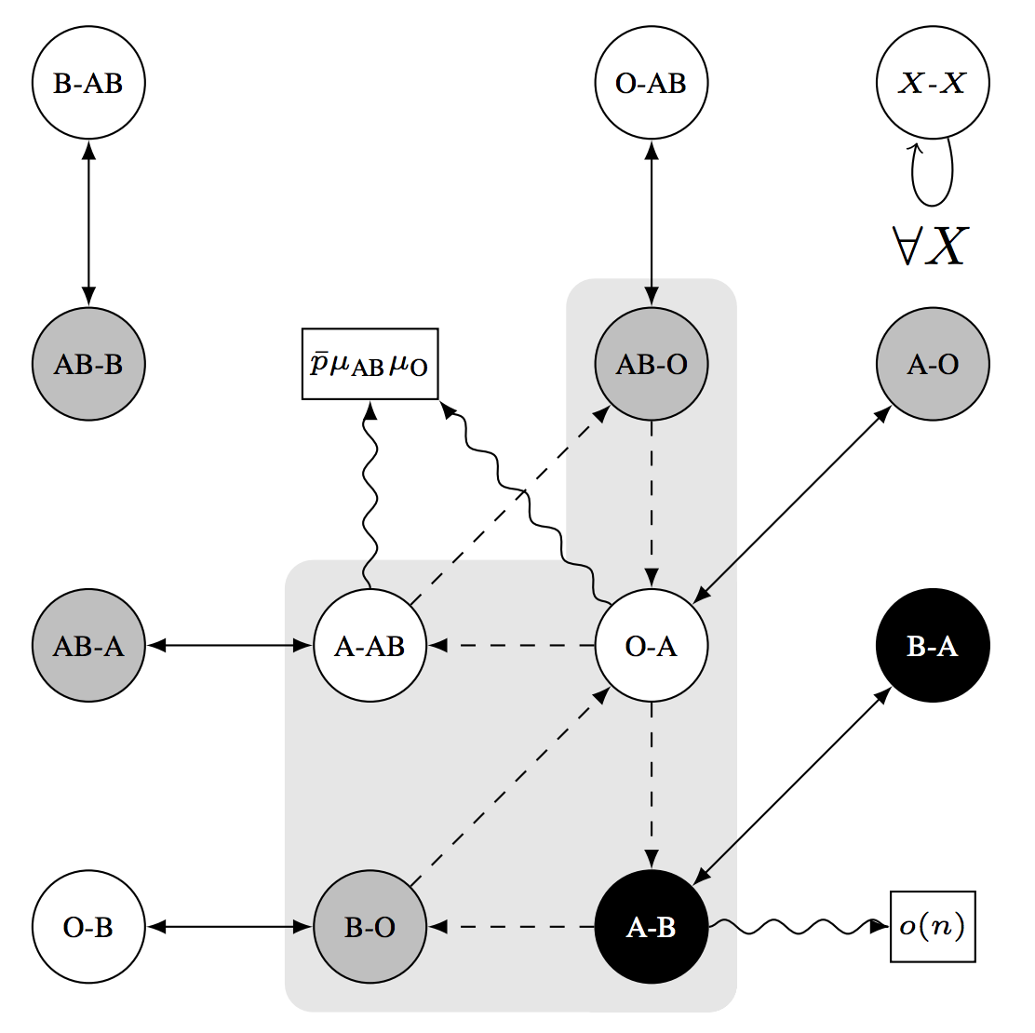
Random Graph Theory

Slide 48
Next class: Game Theory Primer

